Slide 1

“Brain Tumor Detection Using Deep Learning”
Department Of Computer Science and Engineering Jawaharlal Darda Institute of Engineering & Technology, Yavatmal, (M.S), India-445001 Session 2023-2024
Presented by :
Mr. Chetan A. Muneshwar
Mr. Raunak J. Pipariya
Mrs. Shreya N. Nathile
Mr. Amit S. Khandare
Guided by :
Prof. M. K. Popat

Slide 2
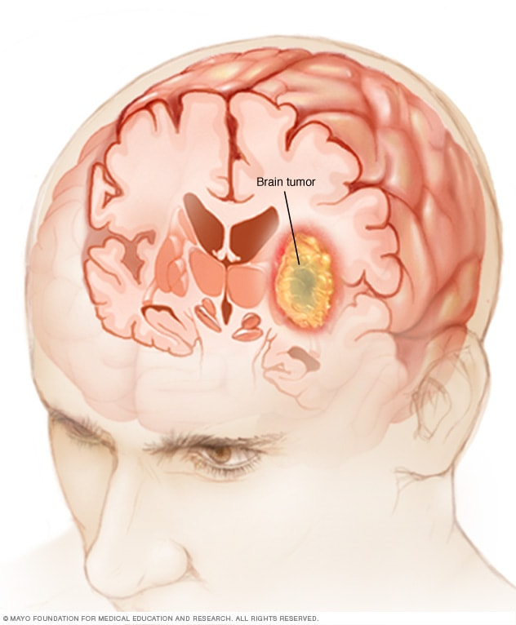
CONTENTS:
Abstract
Introduction
Problem Statement
Literature Review
Objective
Technology used
Research Methodology
Data Flow Diagram
Flowchart and Working
Advantages
Impact on Society, Environment and Sustainability
Conclusion
References

Slide 3
Abstract:
Brain tumor detection is a critical aspect of modern healthcare, as early diagnosis and accurate localization are vital for effective treatment and patient outcomes. Deep learning techniques have shown remarkable potential in addressing this challenge. This study presents a novel approach for brain tumor detection using deep learning mechanism.
We employ a convolutional neural network (CNN) architecture that is tailored to analyze medical images, specifically magnetic resonance imaging (MRI) scans. The model is trained on a large dataset of annotated MRI images, enabling it to learn intricate patterns and features indicative of brain tumors. The CNN's multi-layered structure enables it to automatically extract relevant features, minimizing the need for handcrafted feature engineering.
Results demonstrate the effectiveness of the proposed approach, achieving high accuracy and sensitivity in brain tumor detection. This approach not only aids in early diagnosis but also offers the potential for real-time detection and localization, contributing to improved treatment planning. The use of deep learning in brain tumor detection holds promise for enhancing healthcare outcomes and reducing the burden on radiologists, paving the way for more efficient and accurate diagnosis and treatment of brain tumors.
Keywords: Brain tumor detection, Deep learning, Convolutional neural network (CNN), Medical images, Healthcare, Magnetic resonance imaging (MRI)

Slide 4
Introduction:
Tumor: A tumor is tissue that is growing where it should not be. Another name of tumor is neoplasm. A tumor is usually form as lump or mass. Tumors are either malignant(harmful) or benign(safe) tumors. Cancer for examples is malignant and sometime spreads to other places on body. Tumor can occur in many different parts of the brain, and it may be classified as primary tumor or secondary tumor.
Brain Tumor: A brain tumor is a growth of abnormal cells in the brain. The anatomy of the brain is very complex, with different parts responsible for different nervous system functions. Brain tumors can develop in any part of the brain or skull, including its protective lining, the underside of the brain (skull base), the brainstem, the sinuses and the nasal cavity, and many other areas. There are more than 120 different types of tumors that can develop in the brain, depending on what tissue they arise from.
Our project has been classified into two broad categories.
1. Patients with brain tumor
2. Patient with no Brain tumor
We have further classified Brain tumor into three main Categories
Glioma
Meningioma
Pituitary

Slide 5
Problem Statement:
The current system has certain problems in Brain tumor detection. It's important to note that advancements and changes may have occurred in the field of brain tumor detection since then, some of the ongoing challenges that were present at that time are Limited Access to High Quality Data, Ongoing Model Maintenance, False Positives and Negatives, Data Imbalance, Model Interpretability, Regulatory Compliance, etc.
To solve this problems we can simply use Deep Learning to detect brain tumor.

Slide 6
Literature Review:
Image Analysis for MRI Based Brain Tumor Detection and Feature Extraction Using Biologically Inspired BWT and SVM - In this paper using MR images of the brain, we segmented brain tissues into normal tissues such as white matter, gray matter, cerebrospinal fluid (background), and tumor-infected tissues. We used pre-processing to improve the signal-to-noise ratio and to eliminate the effect of unwanted noise. We can used the skull stripping algorithm its based on threshold technique for improve the skull stripping performance. A Survey on Brain Tumor Detection Using Image Processing Techniques - This paper surveys the various techniques that are part of Medical Image Processing and are prominently used in discovering brain tumors from MRI Images. Based on that research this Paper was written listing the various techniques in use.
Identification of Brain Tumor using Image Processing Techniques - This paper survey of Identifying brain tumors through MRI images can be categorized into four different sections; pre-processing, image segmentation , Feature extraction and image classification .
Review of Brain Tumor Detection from MRI Images - In this paper, some of the recent research work done on the Brain tumor detection and
segmentation is reviewed. Different Techniques used by various researchers to detect the brain Tumor from the MRI images are described. By this review we found that automation of brain tumor detection and Segmentation from the MRI images is one of the most active Research areas.

Slide 7
Objective:
Brain tumor at early stage is very difficult task for doctors to identify.
MRI images are more prone to noise and other environmental interference.
So, it becomes difficult for doctors to identify tumor and their causes.
So here we come up with the system, where system will detect brain tumor from images.
• Save patient’s time.
• Provide a solution appropriately at early stages.
• Get timely consultation.

Slide 8
Technology Used:
Hardware Requirements:
➢ Processor: Intel Pentium IV or Above
➢ RAM: 4 GB or above.
➢ Storage: 500 GB or above
Software Requirements:
➢ Operating System: Windows 10 or above.
➢ Browser: Chrome, Edge, Brave or any type of browser.
➢ User Interface (UI) Technologies: HTML, CSS, and JavaScript for building the interface.
➢ Programming Languages: Used programming languages suitable for web application development, such as Python 3.12.
➢ IDE: Pycharm (Integrated Development Environment).

Slide 9
Research Methodology:
The system will have mainly five modules.
Dataset: In dataset we can take multiple MRI images and take one as input image
Pre-processing: In pre-processing image to encoded the label and resize the image.
Split the data: In split the data we set the image as Training Data and Testing Data.
Build CNN model: To train Deep Neural network for classification.
Classification: Used to classify the Brain tumor

Slide 10
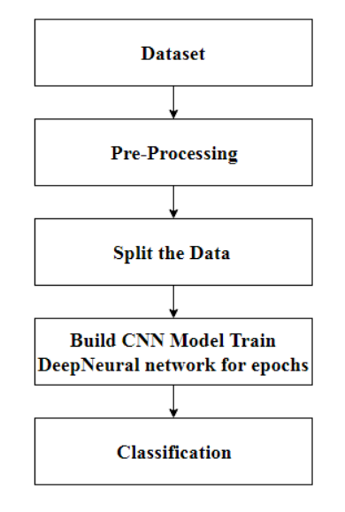
Data Flow Diagram:
START
END

Slide 11
Flowchart:
Start
Input MRI Image from dataset
Image Preprocessing
CNN feature Extraction + Classification
If Tumor is detected
?
NO
YES
Preprocessing
Normal
Segmentation
Area of classification of brain tumor
Glioma
Meningioma
Output
Pituitary

Slide 12
WORKING:
Start: The process begins here.
Input MRI Image from dataset: An MRI image is taken as input from a dataset. This image likely contains brain scan data.
Image Preprocessing: The input image undergoes preprocessing steps. These steps may involve noise reduction, contrast enhancement, and other techniques to prepare the image for further analysis.
CNN Feature Extraction + Classification: A Convolutional Neural Network (CNN) is used for feature extraction and classification. CNNs are commonly used for image analysis tasks. Features relevant to brain tumor detection are extracted from the preprocessed image.
Is Tumor detected?:
If the CNN detects a tumor, the flow proceeds to the “YES” path.
If no tumor is detected, the flow proceeds to the “NO” path.

Slide 13
6. NO (Normal): If no tumor is detected, the result is classified as “Normal.”
7. YES (Tumor Detected):
Further processing steps are performed for the detected tumor.
These steps may include additional preprocessing and segmentation.
8. Segmentation Area of classification of brain tumor:
The tumor area is segmented to classify it into specific types.
The three possible classifications are:
Glioma
Meningioma
Pituitary
9. Output: The final output provides the classification of the brain tumor based on the MRI image.

Slide 14
Algorithm use in project:
CNN Algorithm:
CNN's, also known as Convolutional Neural Network, consist of multiple layers and are mainly used for image processing and object detection.
CNN's are widely used to identify satellite images, process medical images, forecast time series.
CNN's have multiple layers that process and extract features from data:
Convolution Layer:
CNN has a convolution layer that has several filters to perform the convolution operation.
Rectified Linear Unit (ReLU):
CNN's have a ReLU layer to perform operations on elements. The output is a rectified feature map.

Slide 15
Pooling Layer:
The rectified feature map next feeds into a pooling layer. Pooling is a down-sampling operation that reduces the dimensions of the feature map.
The pooling layer then converts the resulting two-dimensional arrays from the pooled feature map into a single, long, continuous, linear vector by flattening it.
Fully Connected Layer:
A fully connected layer forms when the flattened matrix from the pooling layer is fed as an input, which classifies and identifies the images.
Padding:
Padding is incorporating a zero layer outside the input volume so the data on border won't be lost and we can get a similar dimension of output as input volume. Here we are using zero padding.

Slide 16
Advantages:
1. High Accuracy
2. Early Detection and Treatment
3. Non-invasive
4. Time and Cost Efficiency:

Slide 17
Impact on Society, Environment and Sustainability
In this part of the study, we look into the influence that the research has had on society as a whole, as well as the environment and the capacity to support it. We investigate how the application of deep learning techniques in the diagnosis of brain tumors might provide major advantages to society, including improvements in healthcare outcomes, greater diagnostic accuracy, and prompt treatments. In addition, we explore the possible environmental consequences of our findings, such as a reduced dependence on invasive procedures and unneeded imaging tests, which will lead to more sustainable healthcare practices and a lower environmental imprint in the area of medical imaging.
Impact on Society
Impact on the environment
Ethical Aspects
Sustainability Plan

Slide 18
CONCLUSION:
In our study, we utilized a dataset of Brain MRI images and applied four Convolutional Neural Network (CNN) models for the task of classifying the scans into four different classes: Glioma, Meningioma, No tumor, and Pituitary. The purpose was to evaluate the performance of these models in accurately identifying brain tumor.

Slide 19
REFERENCES:
Minu Samantaray, Millee Panigrahi, K.C. Patra, Avipsa S. Panda, Rina Mahakud “An adaptive filtering technique for brain tumor analysis and detection” 2016 10th International Conference on Intelligent Systems and Control (ISCO)
2. Sneha Grampurohit, Venkamma Shalavadi, Vaishnavi R. Dhotargavi, Megha Kudari, Mrs Soumya Jolad “BRAIN TUMOR DETECTION USING DEEP LEARNING MODELS” 2020 IEEE India Council International Subsections Conference (INDISCON)
3. Avigyan Sinha, Aneesh R P, Malavika Suresh, Nitha Mohan R, Abinaya D, Ashwin G Singerji “Brain Tumor Detection Using Deep Learning” 2021 Seventh International conference on Bio Signals, Images, and Instrumentation (ICBSII)
4. S. Pereira, A. Pinto, V. Alves, C.A. Silva. (2016). “Brain tumor segmentation using convolutional neural networks in MRI images”, IEEE transactions on medicalimaging,pp.1240-1251, 2016. https://doi.org/10.1109/TMI.2016.2538465.
5. X.W. Gao, R. Hui, Z. Tian. (J2017). “Classification of CT brain images based on deep learning networks, Computer methods and programs in biomedicine”,pp.49-56,Jan2017. https://doi.org/10.1016/j.cmpb.2016.10.007.

Slide 20
ANY QUESTIONS !!!

